Slide 1
How Water Holds Heat Demo/Activity #20

Slide 2
Get Started Now (new sheet)
If an equal amount of water and sand was warmed up by the same amount of heat energy for the same amount of time do you think they would consistently have the same temperature? Explain your answer.

Slide 3
Get Started Now (same sheet as yesterday)
What do you think would happen to the temperatures of 100 g of gold and water if they were heated in two pans in a 250ᵒF oven for 2 minutes AND why do you think that?

Slide 4
What is Specific Heat?
The amount of energy needed to raise 1 g/mL of a substance by 1ᵒC.
This is measured in calories.
The higher the specific heat, the more energy needed to raise the temperature of a substance.
Water has one of the highest specific heat.
Today scientists estimate sea surface temperatures by using satellites to measure the amount of radiation emitted from the surface of the ocean.

Slide 5
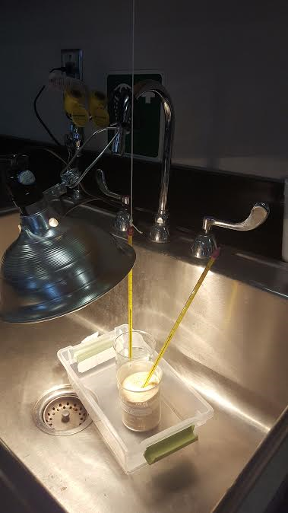
Set Up and Data Collection
Filled 2 containers with 200 mL of water and sand.
Recorded temperature in Celsius with thermometers.
Took readings every minute for 30 minutes (15 with lamp on and 15 with lamp off).

Slide 6
Data Collection and Graphing
Record your data and fill in your data table appropriately.
Plot your data on the graph provided (you may color code if your don’t want to use the key provided).

Slide 7
Post Lab Questions
What were the temperature changes of the sand and the water after 15 minutes under the lamp?
In which substance do you observe the faster increase in temperature?
How many degrees did each substance cool in the 15 minutes after the lamp was turned off?
Which substance retained its heat energy and cooled more slowly?
If the sand and the water received the same amount of heat energy, why were there differences in the heating and cooling rates?
Describe how differences in the rates of heating and cooling of water and sand could cause the climate along the seacoast to differ from that further inland.

Slide 8
Assessing what you learned.
What do you think would happen to the temperatures of 100 g of gold and water if they were heated in two pans in a 250ᵒF oven for 2 minutes AND why do you think that?
Write a paragraph (4 sentences minimum) about what you did in the activity and explain what your results were, as well as, what you learned. What were some variables that could have altered the results?

Slide 9
Extension (Extra Credit)
Investigate why more than half of the world’s population lives along the coastline? Make sure the connection is climate/heat transfer related.
Because of the climate of the Great American Desert, far from oceans, what hardships did the pioneers endure on wagon trains of the 1800’s? Specifically the Oregon Trail or California Trail.
Compare the livelihoods of a coastal Native American tribe with that of an interior tribe. How were these tribes’ methods of finding sustenance and their customs influenced by the climate?

