Slide 1
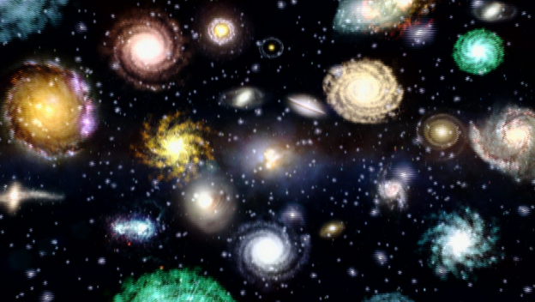
How have Theories of the formation and structure of the universe changed?
S6E1a. Relate the Nature of Science to the progression of basic historical scientific models (geocentric, heliocentric) as they describe our solar system, and the Big Bang as it describes the formation of the universe.
Notes:
Instructional Approach(s): Introduce the essential question and the standard for the lesson.

Slide 2
A Scientific Theory is an explanation or model backed by results obtained from many tests or experiments.
Notes:
Instructional Approach(s): Teacher provides definition of a scientific theory and the students record the definition on their notes.

Slide 3
Why do theories change?
Scientific theories change when scientists discover new information
New technology, new tools, and/or new observations can provide new information.
Think back to the Theory Challenge Activity. What new technology and/or tool was mentioned?
Greater telescopes and imaging technology
Notes:
Instructional Approach(s): Teacher asks the students “why do theories change?” and gather a few responses from students. If students cannot come up with responses, let them pair up and possible discuss with another student. However, do not spend more than 2-3 minutes discussing why theories change. After discussions, allow students to answer the question on their notes.

Slide 4
For centuries, there have been a variety of theories to explain the formation and structure of the universe.
We will examine some of these theories and identify the most widely accepted theory today.
Notes:
Instructional Approach(s): Teacher reads the slide as a transition to the theories of the universe.

Slide 5
How and when did the universe begin? No one was around when the universe began, so who can say what really happened?
The best that scientists can do is work out the most foolproof theory, backed up by observations of the universe.
Notes:
Instructional Approach(s): Teacher reads that slide as a transition to the Big Bang Theory.

Slide 6
The Big Bang Theory
The most commonly accepted theory today of the formation of the universe is the Big Bang Theory.
The theory states that the universe originated sometime between 10 billion and 20 billion years ago from an enormous explosion of a small volume of matter at extremely high density and temperature.
Notes:
Instructional Approach(s): The teacher introduces the Big Bang Theory and the students answer a question on their notes about the Big Bang Theory.

Slide 7
In spite of its problems, the Big Bang is still considered by most astronomers to be the best theory we have.
As with any scientific hypothesis, however, more observation and experimentation are needed to determine its credibility.
Notes:
Instructional Approach(s): Teacher reads or has students read the information on the slide. Possibly discuss briefly with the class about the impact of technology and how quickly technology changes. Additionally, theories may change more quickly now than in the centuries before because of the constant changes in technology and the new evidence that might be discovered.

Slide 8
another theory about the universe…
Big Bang theorists claim that all of the galaxies, stars, and planets still hold the explosive motion of the moment of creation and are moving away from each other at great speed.
In 1929, astronomer Edwin Hubble announced that all of the galaxies he had observed were moving back from us, and from each other, at speeds of up to several thousand miles per second.
Since the Big Bang explosion, they reason, the universe has been expanding.
Notes:
Instructional Approach(s): The teacher reads through the information or has students read the information. The third bullet is the “big idea” of the slide. The students should answer the question on their notes about “another theory that is closely associated with the Big Bang Theory”.

Slide 9
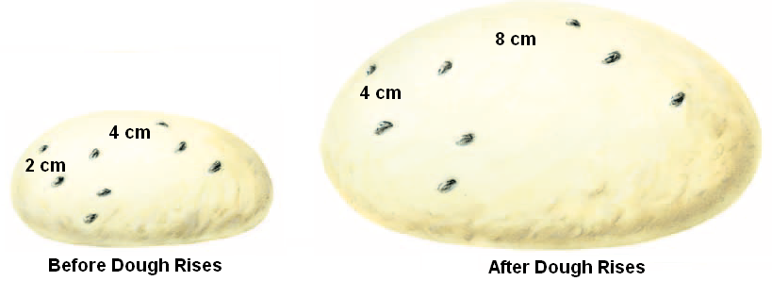
Astronomers use the analogy of cooking raisin bread to demonstrate the expanding universe
Expanding the Universe on a Balloon Demo
Notes:
Instructional Approach(s): The teacher uses the illustration of cooking raisin bread as an example of the expansion of the universe. Students should explain on their notes how cooking raisin bread demonstrates the expansion of the universe. Another approach is to conduct the Expanding the Universe on a Balloon Demonstration. See “Expanding the Universe on a Balloon Demonstration” on the resource page with teacher directions for conducting the demonstration.

Slide 10
the Universe After its Big Bang…
The Universe includes living things, planets, stars, galaxies, dust clouds, light, and even time.
The Universe contains billions of galaxies, each containing millions or billions of stars. The space between the stars and galaxies is largely empty.
So, if the universe supposedly was formed by the Big Bang, how did these other objects form?
Notes:
Instructional Approach(s): Teacher reads the slide to transition to the next concept.

Slide 11
the Universe After its Big Bang…
As millions of years passed, the dense areas of the universe pulled in material because they had more gravity. Finally, about 100 million years after the Big Bang, the gas became hot and dense enough for the first stars to form. Large clusters of stars soon became the first galaxies.
Scientists believe that Solar Systems formed in similar ways. Giant clouds of dust and gas began to collapse under the weight of its own gravity. As it did so, the matter contained within it began to move in a giant circle, much like the water in a drain moves around the center of the drain in a circle.
In short, after the Big Bang, dense clouds of gas and dust from the “bang” either collapsed or stuck together to form the parts of the universe we know today.
Further away from the center of this mass where the star was forming, there were smaller clumps of dust and gas that were also collapsing.
The star in the center eventually ignited forming our Sun, while the smaller clumps became the planets, minor planets, moons, comets, and asteroids.
At the center of this spinning cloud, a small star began to form. This star grew larger and larger as it collected more and more of the dust and gas that collapsed into it.
Notes:
Instructional Approach(s): The teacher should slowly take the students through the animated ppt slide describing what happened after the “big bang”. At the end of the slide, an “in short” box summarizes the events that led to the formation of other objects in our solar system. The students should record how other parts of the universe were formed on their notes.

Slide 12
anOther Theory which has changed over centuries is the scientific model of our solar system
Notes:
Instructional Approach(s): Teacher should read the first bullet slide that leads to the next activity, Great Debate! Model of the Solar System Activity.

Slide 13
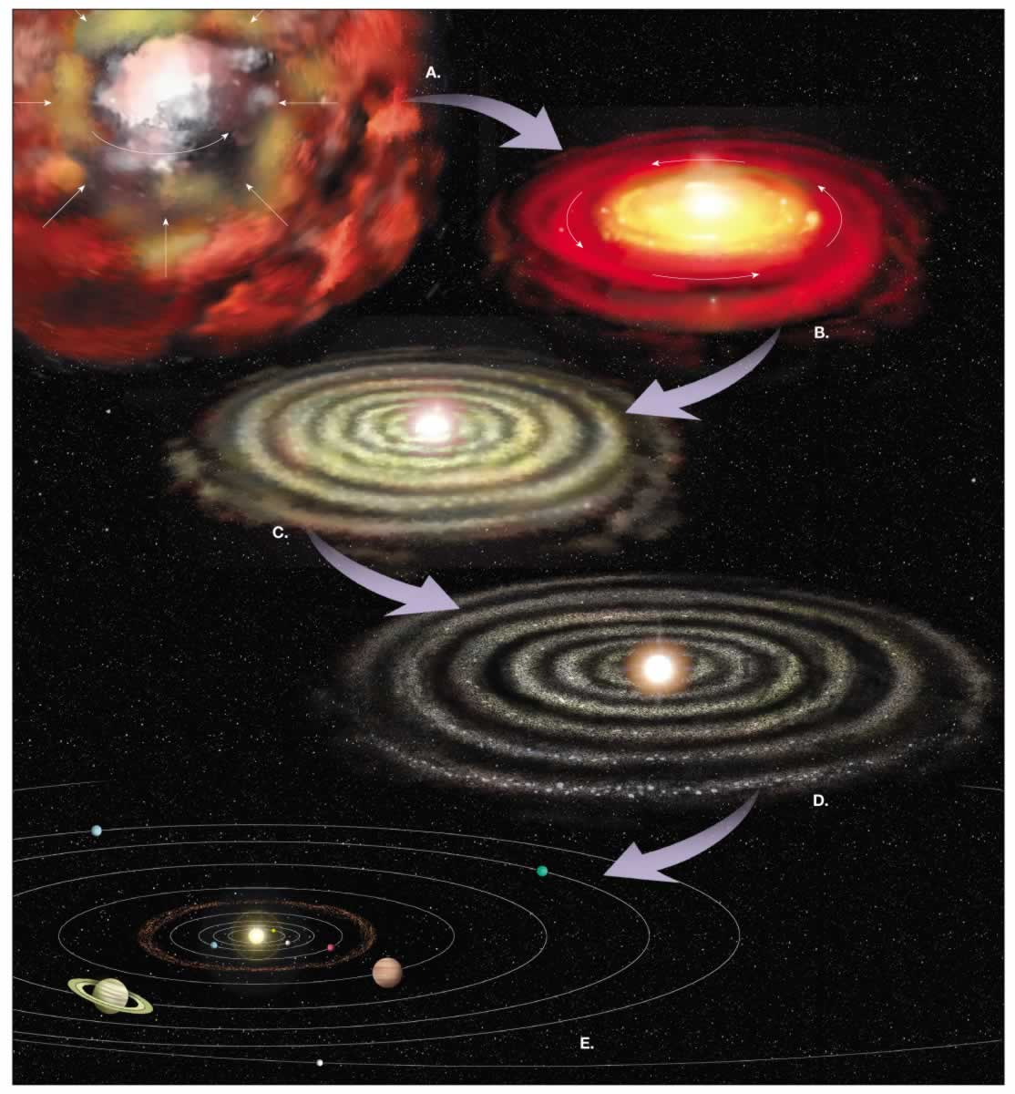
Notes:
Instructional Approach(s): Teacher uses the picture to show how the universe was formed over time in the Big Bang Theory

Slide 14
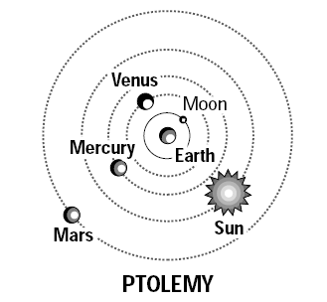
Ptolemy’s Model of the Solar System
Ptolemy’s theory is known as the Geocentric Model because he thought the Earth was the center of the universe
In Greek, “Geo” means earth
He believed his theory for several reasons
Gravity of all objects were attracted to the earth, which suggested to him that the earth must be the center.
He thought the Earth did not move because objects fell in the same place if thrown up in the air. He thought if the earth moved, objects would fall in a different place.

Slide 15
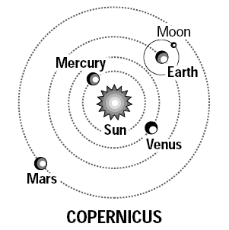
Copernicus’ Model of the Solar System
Copernicus’ theory is called the Heliocentric Theory because he thought the sun was the center of the universe.
In Greek, “helios” means sun
Galileo made additional observations using a telescope which supported the heliocentric theory.
Galileo observed that Venus went through a full cycle of phase’s like the Moon. This could only be explained if Venus were orbiting the Sun.

