Slide 1
Essential Question: What happens to the energy Earth receives from the Sun?
Standard(s): S6E3b. Relate various atmospheric conditions to stages of the water cycle
S6E2c. Relate the tilt of the earth to the distribution of sunlight throughout the year and its effects on climate
Notes:
Instructional Approach(s): The teacher should introduce the essential question and the standards that align to the essential question.

Slide 2
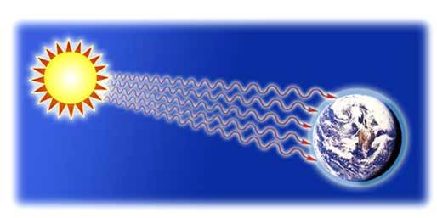
Earlier you learned that solar radiation (Energy) from the Sun heats the Earth’s surface.
Notes:
Instructional Approach(s): The teacher should present the information on the slide.

Slide 3
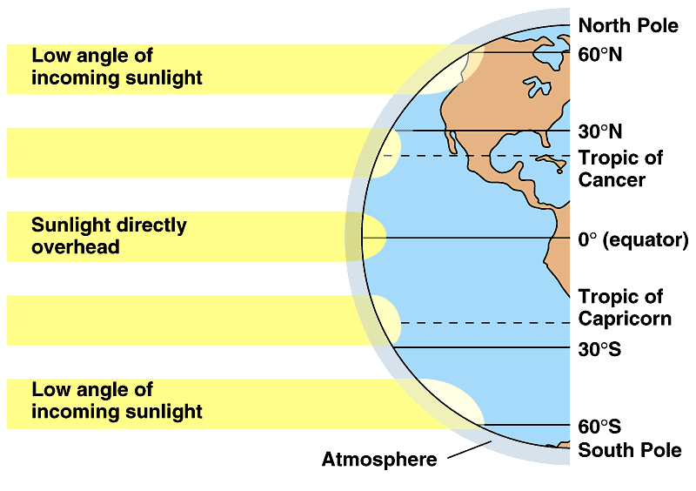
Areas at a higher angle (closer to 90°) receive more total solar radiation (energy) than areas where sunlight strikes at a lower angle.
Notes:
Instructional Approach(s): The teacher should review the information on the slide from a previous lesson.

Slide 4
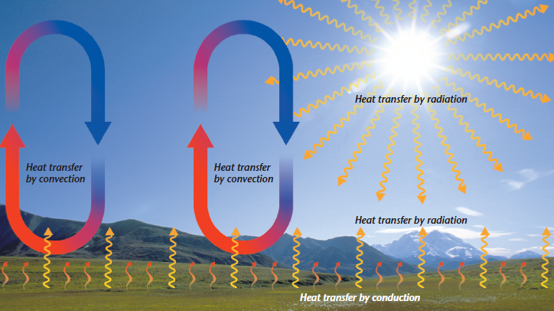
The Sun’s energy (heat) is transferred through the atmosphere in three ways – Radiation, Conduction, and Convection
Notes:
Instructional Approach(s): The teacher should present the information on the slide.

Slide 5
Energy from the Sun is known as heat transfer by Radiation.
Notes:
Instructional Approach(s): The teacher should present the information on the slide.

Slide 6
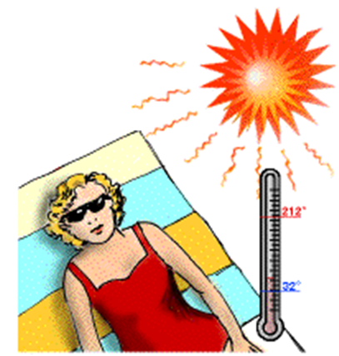
Radiation is energy that is transferred in the form of rays or waves.
Radiation allows you to feel heat (energy) even though you are not in direct contact with it.
Notes:
Instructional Approach(s): The teacher should present the information on the slide.

Slide 7
Radiation Examples
Example 1
Example 2

Slide 8
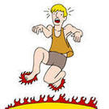
If you walk barefoot on a hot beach or pavement, your feet heat up because of conduction.
Conduction is the transfer of energy (heat) that occurs when objects are in contact. Energy is transferred from warmer objects to cooler objects.
Notes:
Instructional Approach(s): The teacher should present the information on the slide. Show the animation to illustrate the concept of conduction.

Slide 9
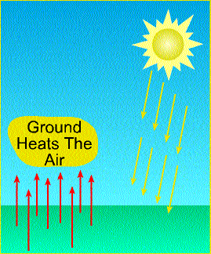
Radiation heats the Earth’s surface. As air moves over warm land or water, molecules in air are heated by Conduction (direct contact).
Notes:
Instructional Approach(s): The teacher should present the information on the slide.

Slide 10
Conduction Examples
Example 1
Example 2

Slide 11
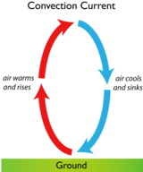
After the atmosphere is warmed by radiation or conduction, the energy (heat) is transferred by Convection.
Convection is the transfer of heat by the flow of material. Convection circulates heat throughout the atmosphere.
Notes:
Instructional Approach(s): The teacher should present the information on the slide.

Slide 12
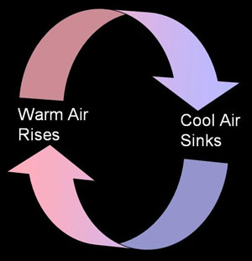
Warmer air rises and cool air sinks forming a convection current.
Think, Pair, Share
Why does warm air rise and cool air sink?
Notes:
Instructional Approach(s): The teacher should present the information on the slide. Then students “Think” about the question on their own for about 30 seconds or less. Then “Pair and Share”. . Partners can be determined by the students or the teacher can provide more specific directions such as turn to the person directly in front/behind you or to the right/left of you, etc. It may be necessary to have a group of three if you have an uneven number of students. Do not allow more than 30 seconds to 1 minute of discussion time. The teacher should be walking around listening and redirecting discussions as needed. The teacher can briefly discuss student responses. When ready, click to the next slide to discuss the answer.

Slide 13
When air is warmed, the molecules in it move apart and the air becomes less dense (air pressure decreases).
In cold air, molecules move closer together becoming more dense (air pressure increases). Cold air is “heavier” so it sinks while “lighter” warm air rises.
Notes:
Instructional Approach(s): The teacher should present the information on the slide answering the question on the previous slide.

Slide 14
Convection Examples
Example 1
Example 2
Notes:
Instructional Approach(s): The teacher should show the animation to illustrate the concept of convection currents. Convection currents will be covered more in-depth in the weather and climate unit. This lesson is just an introduction to the concept.

Slide 15
Radiation, Conduction, and Convection together distribute the Sun’s energy (heat) throughout the Earth’s atmosphere.
Notes:
Instructional Approach(s): The teacher should present the information on the slide.

Slide 16
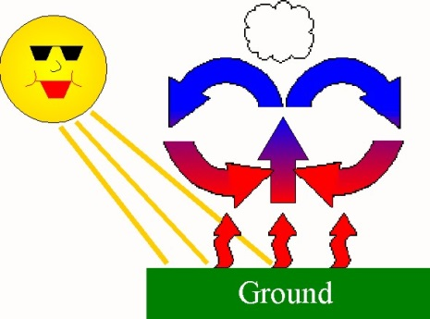
Think, Pair, Share
Identify Conduction, Convection, and Radiation in the diagram below.
A
B
C
Notes:
Instructional Approach(s): Students “Think” about the question on their own for about 30 seconds or less. Then “Pair and Share”. Partners can be determined by the students or the teacher can provide more specific directions such as turn to the person directly in front/behind you or to the right/left of you, etc. It may be necessary to have a group of three if you have an uneven number of students. Do not allow more than 30 seconds to 1 minute of discussion time. The teacher should be walking around listening and redirecting discussions as needed. The teacher should go over the correct answers with the class.

Slide 17
Summarizer
Notes:
Instructional Approach(s): Each student should complete the summarizer. Since this lesson does not directly cover content that is essential, do not differentiate. The concepts will be discussed and covered again in different forms throughout the next unit. This lesson should help lay the foundations for the weather and climate unit.

