Slide 1
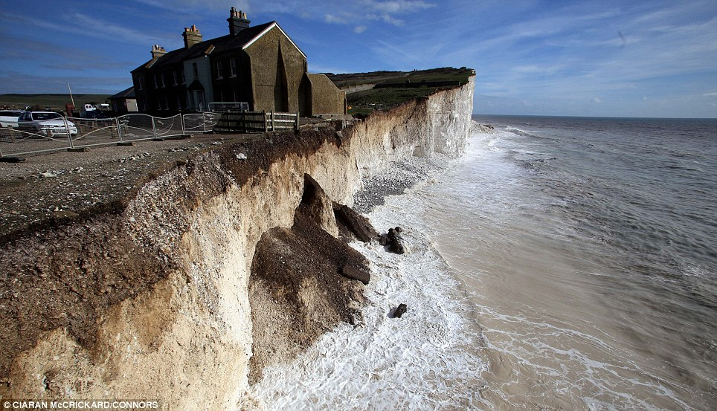
Erosion
Erosion transports weathered rock material.

Slide 2
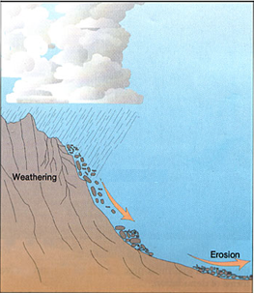
Erosion by Gravity
Rocks and other materials, especially on steep slopes, are pulled toward the center of Earth by gravity.

Slide 3
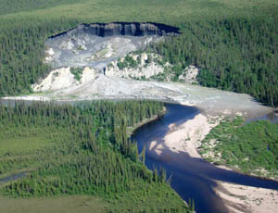
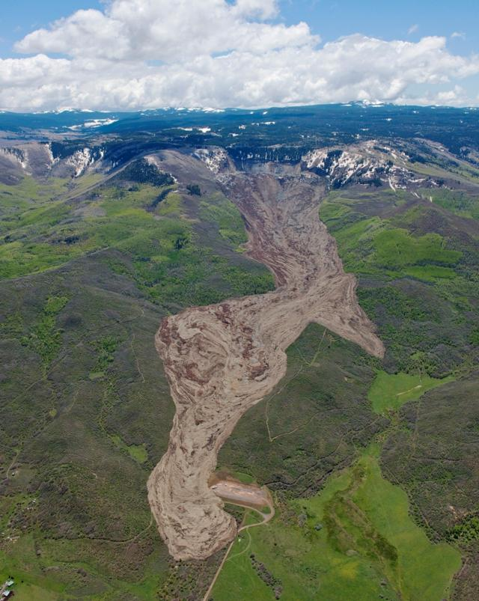
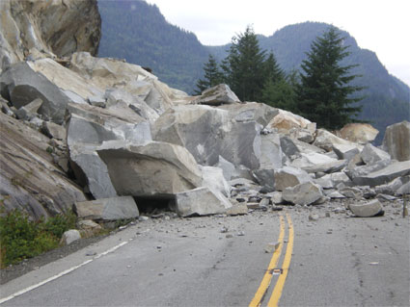
Erosion by Gravity
Slump
Rock Slide
Mud Slide

Slide 4

Erosion by Wind
When air moves, it picks
up loose material and transports it to other places.

Slide 5
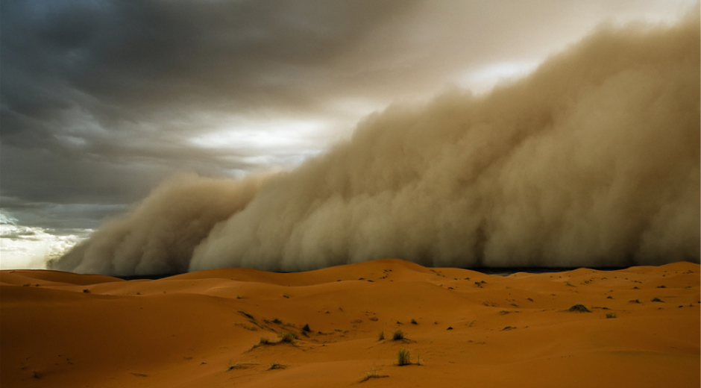
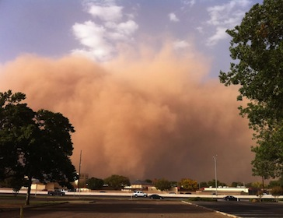
Erosion by Wind
Sandstorm
Dust Storm

Slide 6
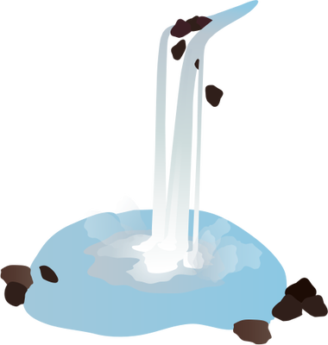
Erosion by Water
When water moves, it picks
up loose material and transports it to other places.

Slide 7
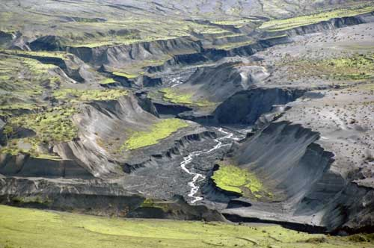
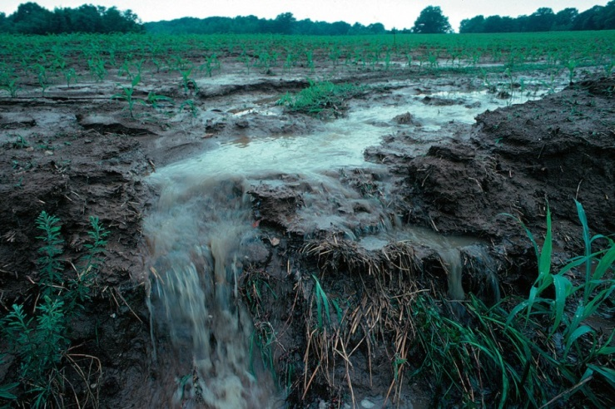
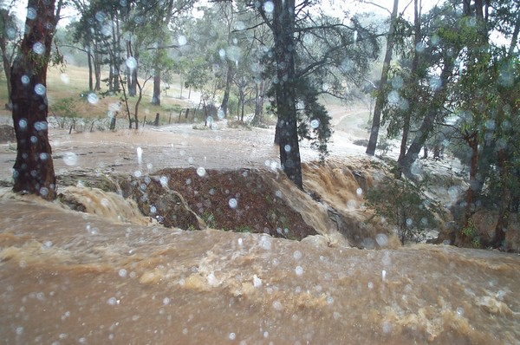
Erosion by Water
Rivers or Streams
Runoff
Flooding

Slide 8
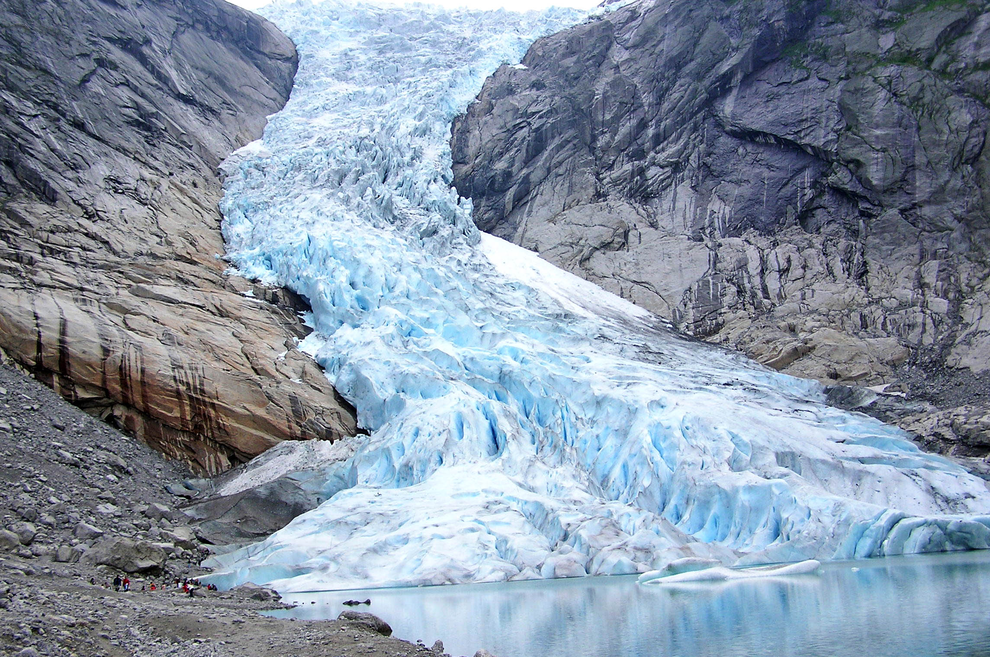
Erosion by Ice
When a glacier moves, it picks up loose material and transports it to other places.

Slide 9
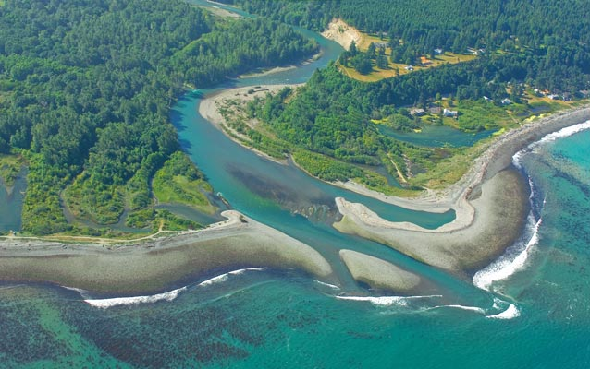
Deposition
Deposition occurs where the agents (forces) of erosion lay sediment down.

Slide 10
Deposition by Water
Water also loses energy and deposits sediment when it empties into an ocean or lake.
Sediment that is deposited as water empties into an ocean or lake forms a triangular shaped deposit (delta).

Slide 11
The Mississippi River flowing into the Gulf of Mexico forms the Mississippi River delta.

Slide 12
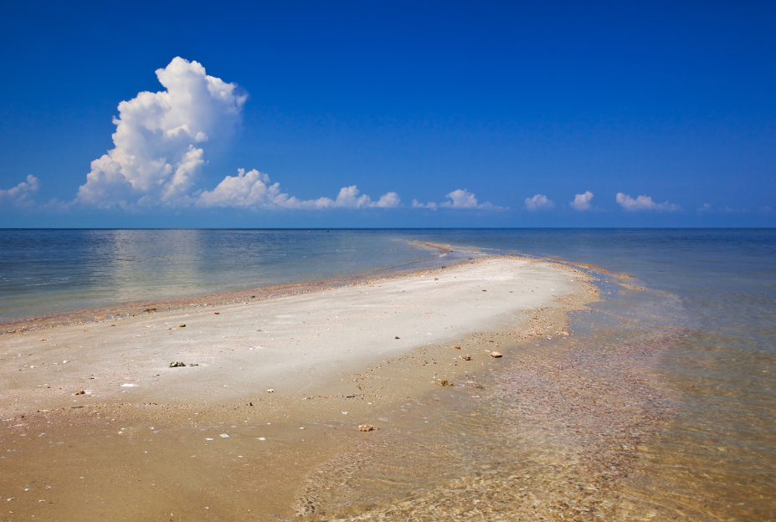
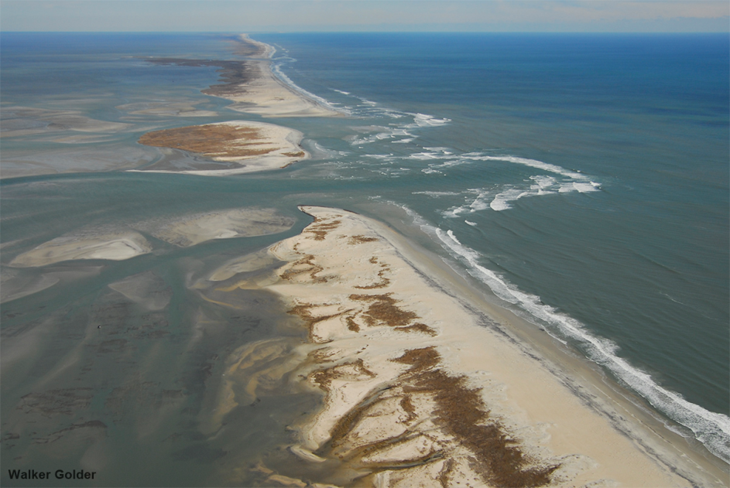
Deposition by Water
Currents, wind, and storms carry and deposit sand along beaches.
Sandbar
Barrier Island

Slide 13
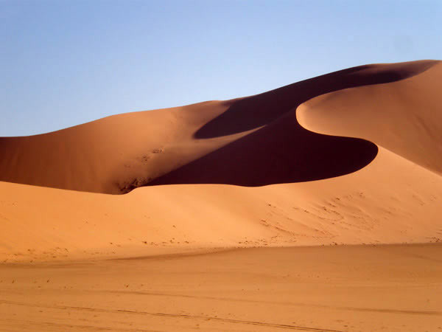
Deposition by Wind
Sediments blown away by wind eventually are deposited. Over time, these deposits develop into landforms.
Sand Dune

Slide 14
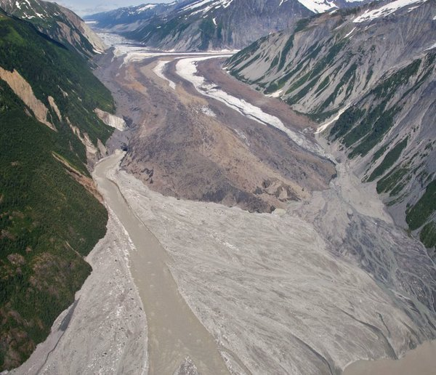
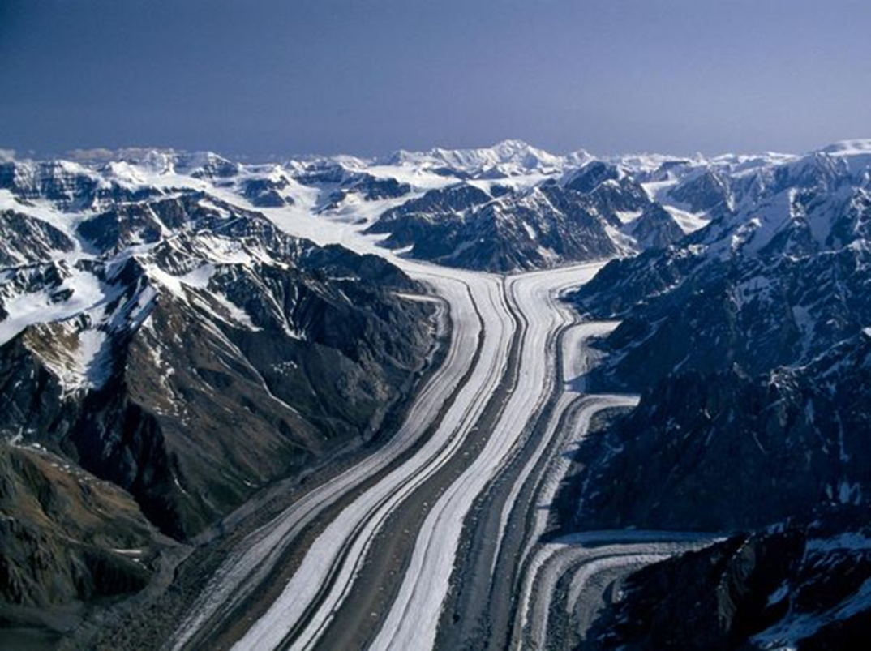
Deposition by Ice
When glaciers begin to melt, they deposit sediment on the land.

