Slide 1
Ocean topography
Subtitle

Slide 2
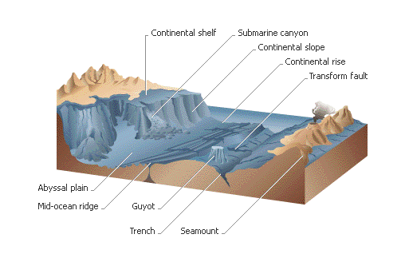

Slide 3
Continental Shelf vs. continental slope
Continental shelf slopes gently down (no deeper than 150 m) and can extend from a few km to hundreds km from shore.
Continental slope drops
sharply (up to 2000 m).

Slide 4
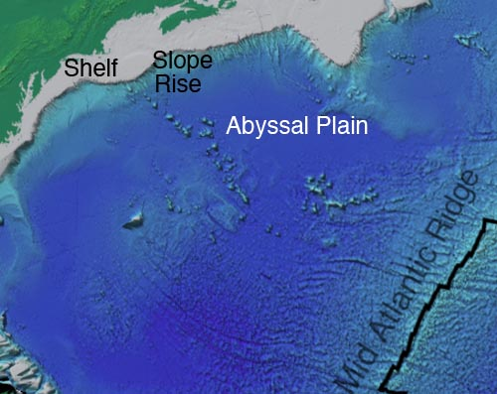
Abyssal Plain
Flattest areas on earth.
Layers of silt, mud, and remains of dead organisms.

Slide 5
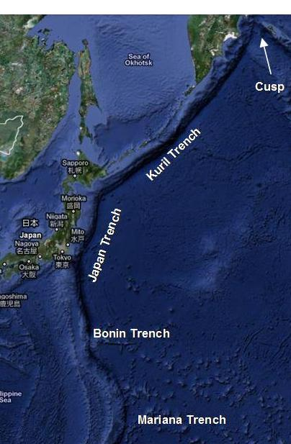
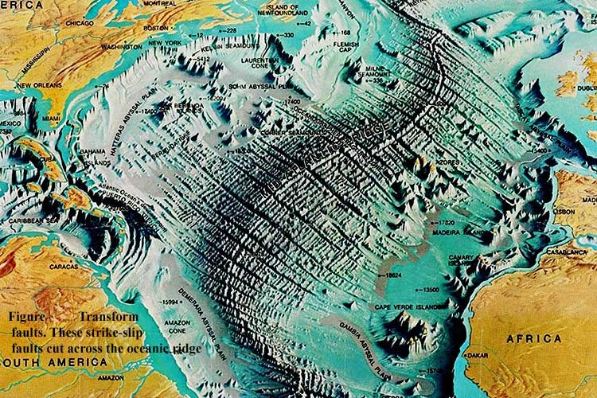
Deep Sea Trench Vs. Mid-ocean ridge
Trenches are underwater canyons, some deeper than the tallest mountains.
Mid-ocean ridges are peaks on
both sides of a central valley (rift valley).

Slide 6
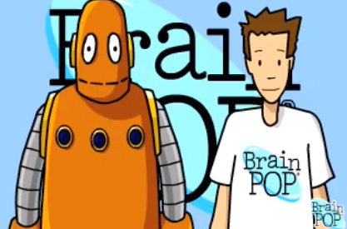
Brainpop video and questions
Watch the video.
Number your paper 11.
Answer Review Questions #1-10
Will pull sticks for answers.

Slide 8
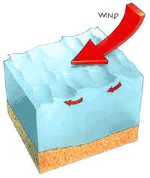
What is a wave?
Waves are movement of energy through a body of water.
Without wind the ocean would be smooth as a mirror.
The size of a wave depends on 3 factors: speed of the wave, length of time it blows, and the distance over which is blows.
http://david.li/waves/

Slide 9
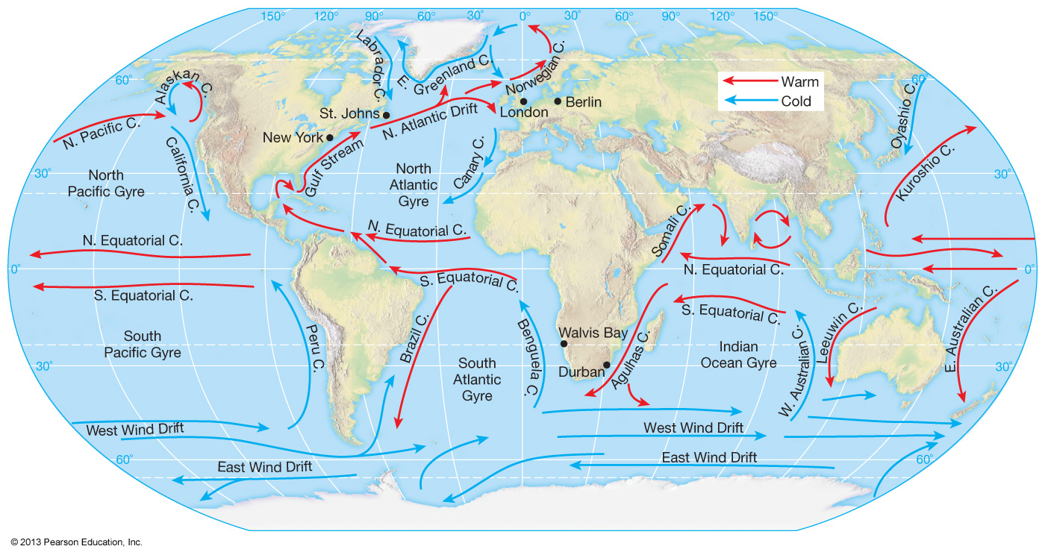
Currents
An ocean current is the movement of ocean water.
Surface currents move along the top part of the ocean and are caused by winds that blow in the same direction most of the time (prevailing winds).

Slide 10
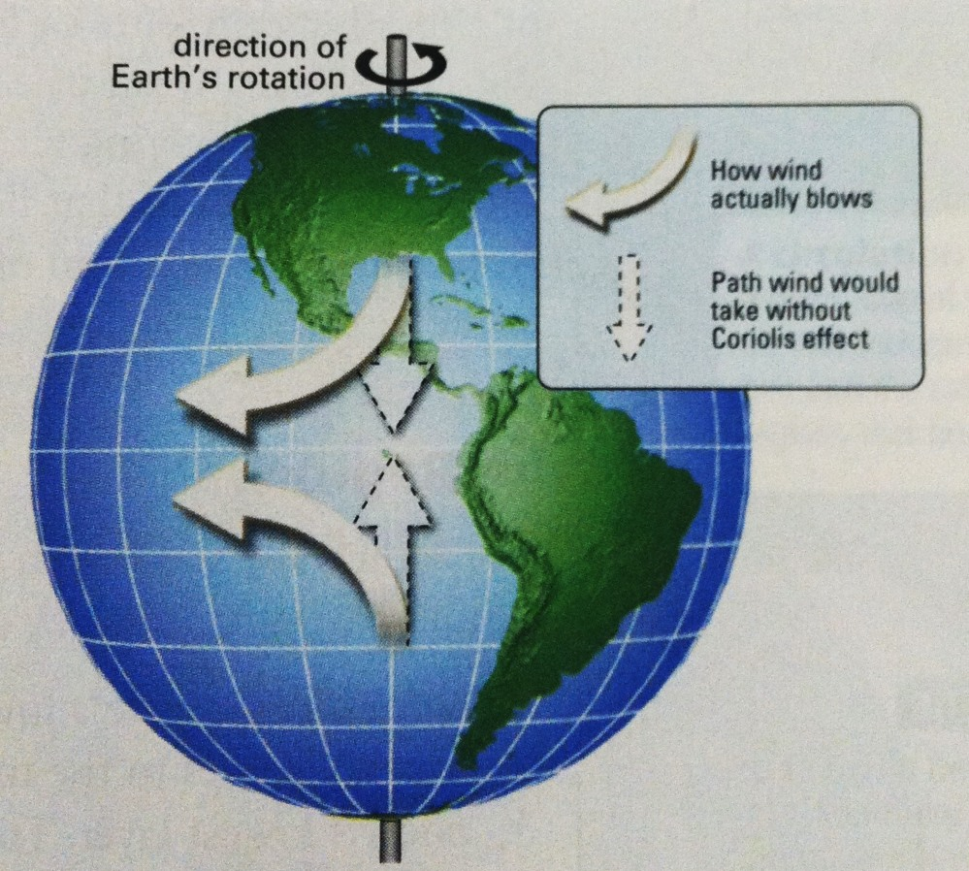
Coriolis effect
Because the earth rotates, the winds and currents
curve to the right in the N. Hemisphere and left in the S.
Hemisphere.

Slide 11
Brainpop video and questions
Watch the video.
Number your paper 11.
Answer Review Questions #1-10
Will pull sticks for answers.

