Slide 1
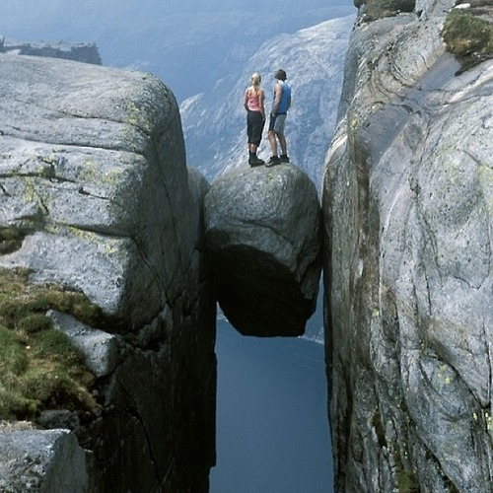

Slide 2
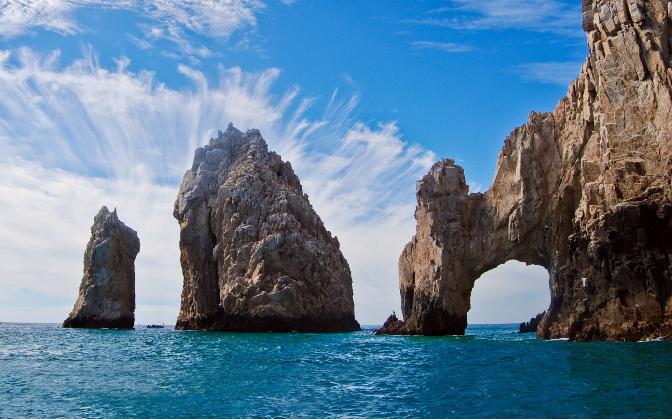

Slide 3
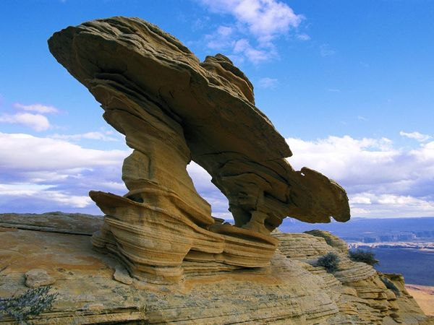

Slide 4
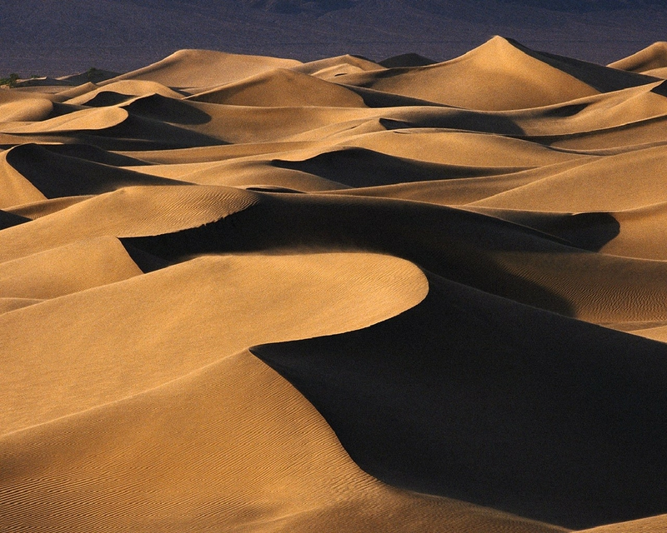

Slide 5
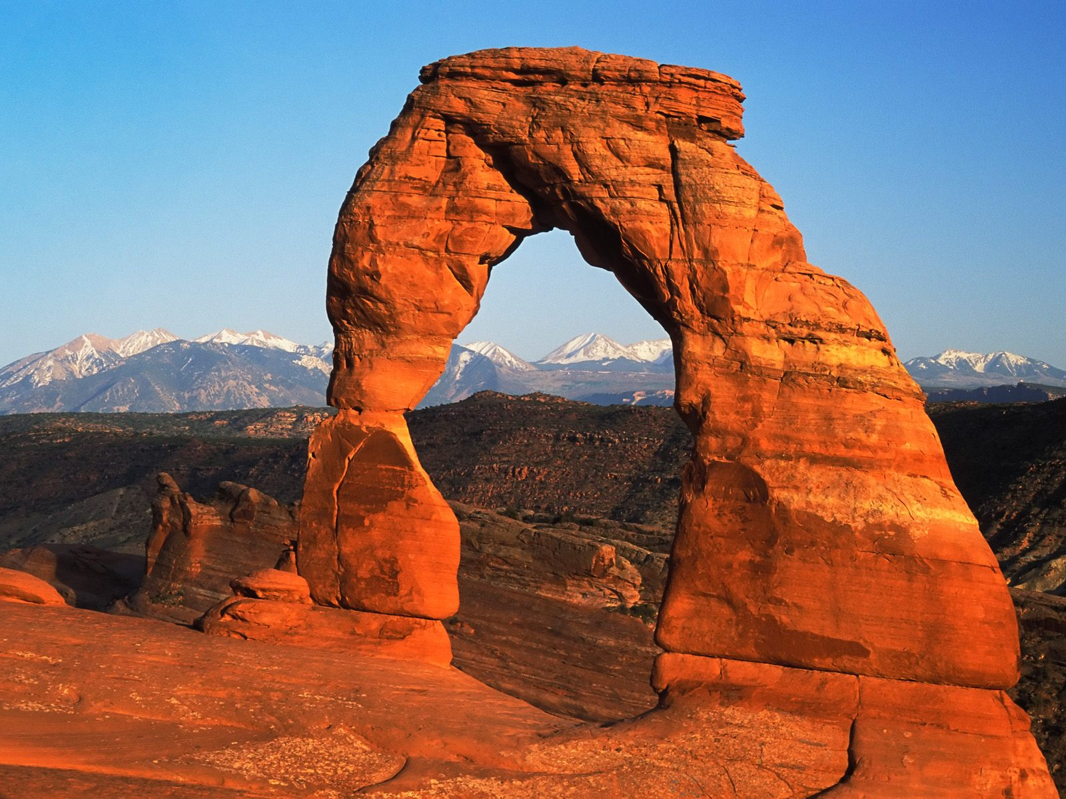
Weathering is the process that breaks down rock and other substances at Earth’s surface.

Slide 6
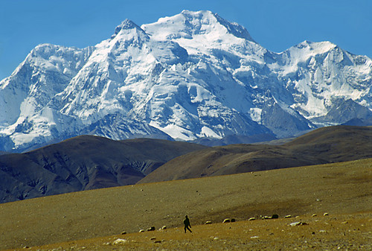
Weathering wears mountains down to hills and can produce strange rock formations like in the previous slide.

Slide 7
Mechanical Weathering
Rocks are broken apart by physical processes (heat, water, ice, pressure, temperature, etc.)
The overall chemical makeup of the rock stays the same
Each piece has characteristics similar to the original rock

Slide 8
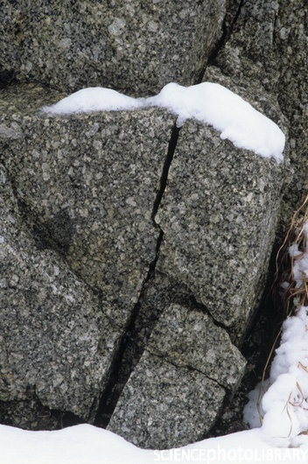
Example of Mechanical Weathering:
Frost Wedging

Slide 9
Mechanical Weathering: Frost Wedging

Slide 10
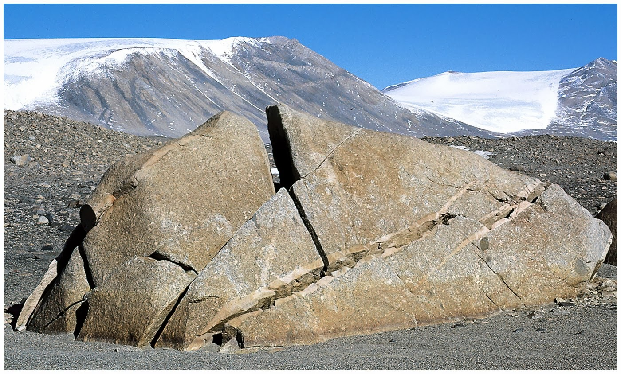
Mechanical Weathering: Frost Wedging

Slide 11
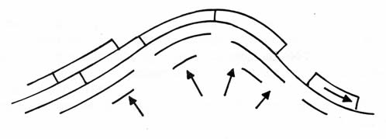
Example of Mechanical Weathering:
Exfoliation

Slide 12
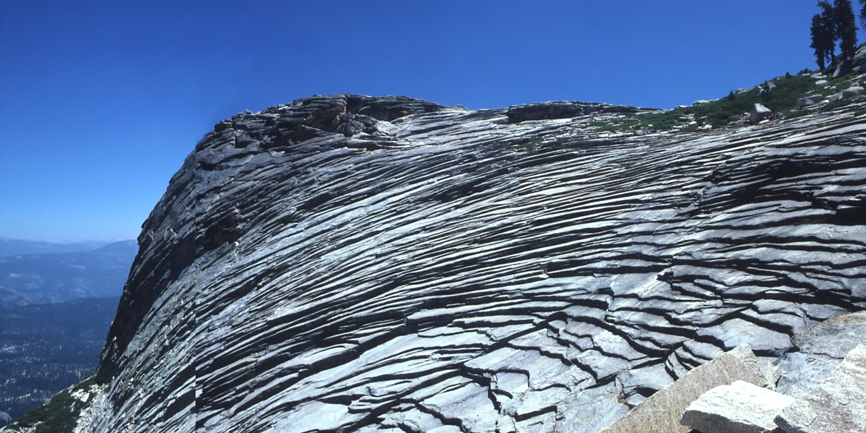
Mechanical Weathering: Exfoliation

Slide 13
Example of Mechanical Weathering:
The expansion and contraction of rock, caused by temperature changes
[Thermal Expansion].
Expand
Contract

Slide 14
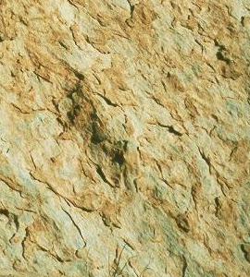
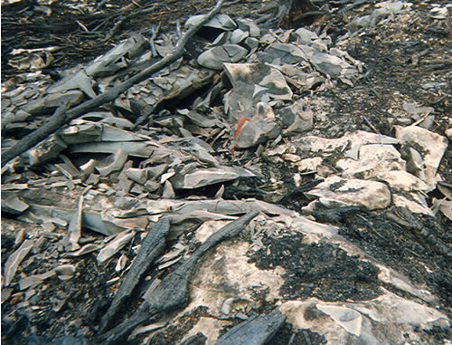
For example, heating of rocks by sunlight or fires can cause expansion of their minerals. This stress eventually cause the rock to crack apart.
Thermal shattering of rock due to a forest fire
The heated exterior will expand faster than the cool interior, causing the exterior to break.

Slide 15
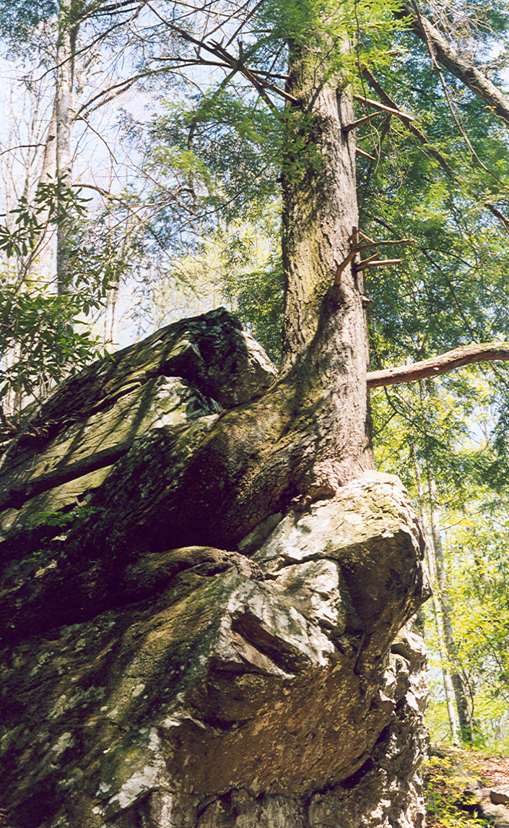
Example of Mechanical Weathering:
Biological Weathering

Slide 16
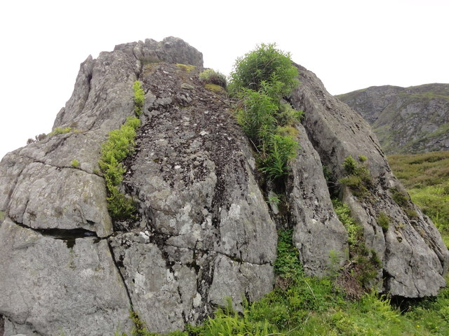
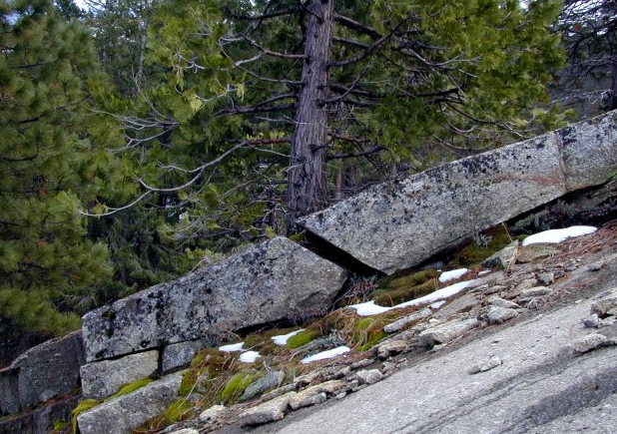
Water and nutrients collect in the cracks of rocks that can result in the growth of plants. As the roots grow, they enlarge the cracks.

Slide 17
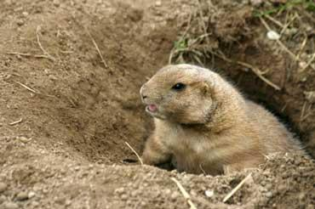
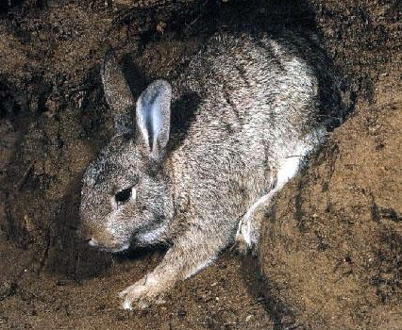
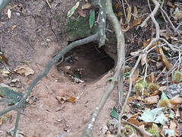
Burrowing animals also cause mechanical weathering. They loosen sediment and push it to the surface as they burrow (dig).

Slide 18
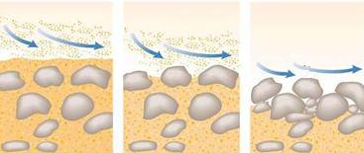
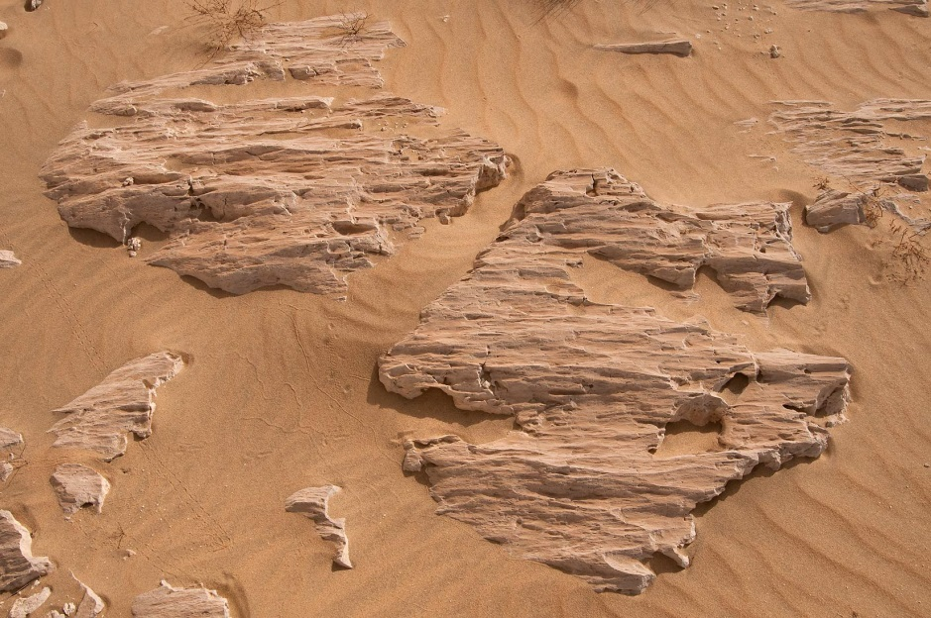
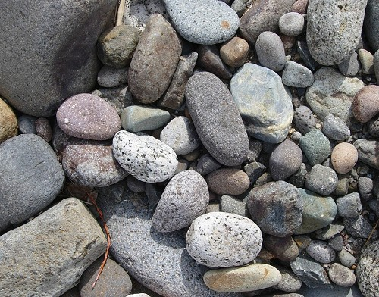
Weathering can also occur by the rubbing of one object or surface
against another [Abrasion].
Rocks and other sediment rubbing against one another
Sand rubbing against the rock

Slide 19
Chemical Weathering
Chemical reactions dissolve or change the minerals in rocks or change them into different minerals [changes the chemical composition]

Slide 20
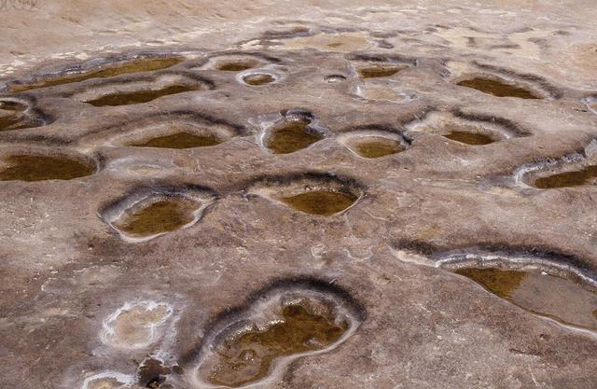
Example of Chemical Weathering:
Rocks and minerals can dissolve in acidic waters [Dissolution].

Slide 21
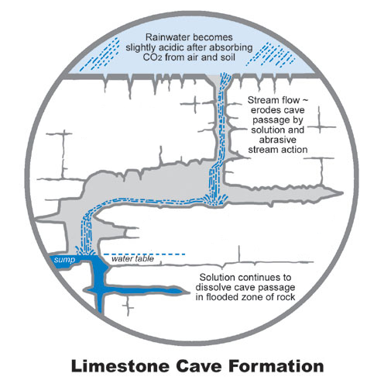
Caves form when slightly acidic groundwater dissolves limestone.

Slide 22
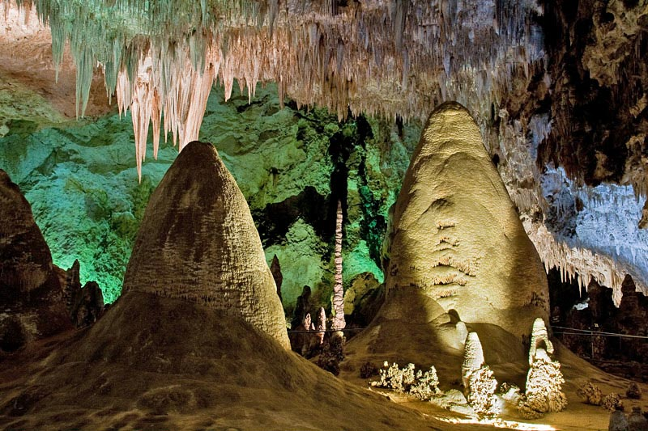
Cave formed by acid dissolved limestone

Slide 23
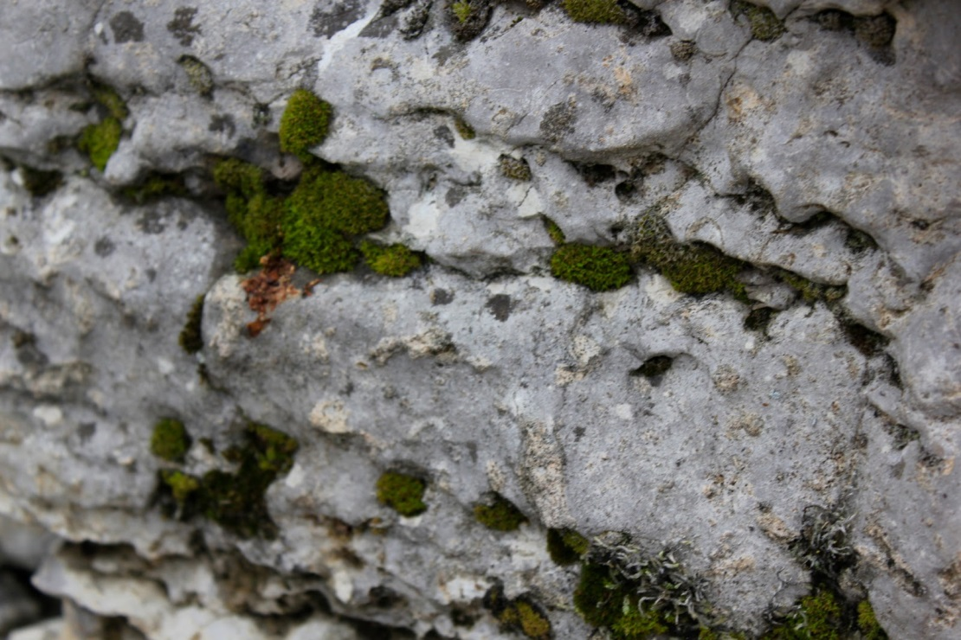
Some plants give off acids that also dissolve minerals in rock. The rock is weakened and eventually breaks into smaller pieces.

Slide 24
Example of Chemical Weathering:
The chemical compounds (mixes) in rock can breakdown due to a reaction with water [Hydrolysis]. An example is Feldspar changing to Clay.

Slide 25
Example of Chemical Weathering:
When minerals containing iron are exposed to water and oxygen in the air, the iron reacts to form a new material that looks like rust [Oxidation].

Slide 26
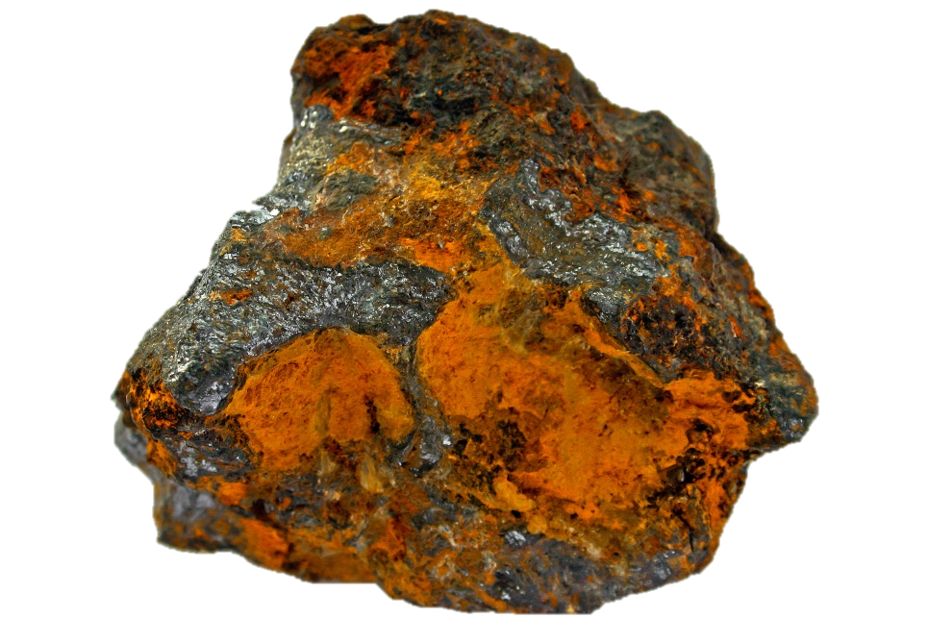
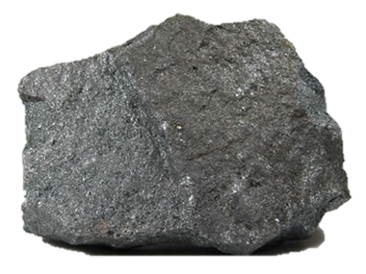
Due to oxidation, iron-containing minerals like magnetite can weather to form a rust-like material called limonite.
Magnetite
Limonite

